Slide 1

Automotive Technology:
A Systems Approach, 8e
Chapter 12: Upper End Theory and Service
Rob Thompson and Jack Erjavec, Automotive Technology: A Systems Approach, 8th Edition. © 2025 Cengage. All Rights Reserved. May not be scanned, copied or duplicated, or posted to a publicly accessible website, in whole or in part.

Slide 2
Chapter Objectives (1 of 2)
12.01 Describe the purpose, operation, and location of the camshaft.
12.02 Inspect the camshaft and timing components.
12.03 Describe the purpose of an engine’s cylinder head, valves, and related valve parts.
12.04 Know why there are special service procedures for aluminum and OHC heads.

Slide 3
Chapter Objectives (2 of 2)
12.05 Describe the types of combustion chamber shapes.
12.06 Do a complete inspection of the cylinder head and valve train parts.
12.07 Describe the different ways manufacturers vary valve timing.
12.08 Inspect and replace valve stem seals. Reassemble a cylinder head.

Slide 4
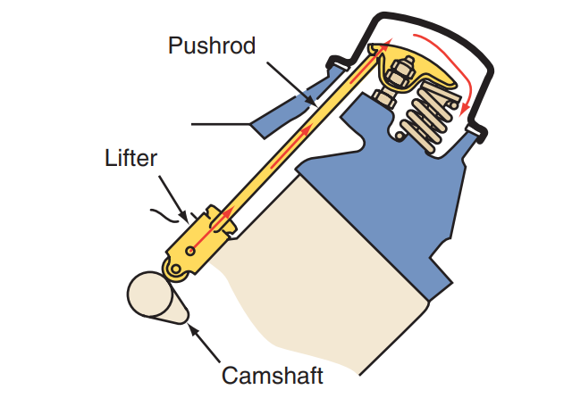
Camshafts (1 of 2)
12.01 Describe the purpose, operation, and location of the camshaft.
A camshaft has a cam lobe for each exhaust and intake valve.
The height of the lobe is proportional to the amount the valve will open.
In all engines, the camshaft converts rotary motion, that of the spinning camshaft lobes, into the linear or reciprocating motion of the valves. In OHC engines, the camshaft fits in a bore in the cylinder head.
On OHV engines, as the cam lobe rotates, it pushes up on the lifter, which moves the pushrod and one end of the rocker arm up.

Slide 5
Camshafts (2 of 2)
Since a rocker arm is a lever, as that end goes up, the other end moves down. Which pushes down on the valve to open it.
As the cam continues to rotate, the valve spring closes the valve while maintaining contact between the valve and the rocker arm, thereby keeping the pushrod and the lifter in contact with the rotating cam.
OHC engines may have separate camshafts for the intake and exhaust valves.
As these camshafts rotate, the lobes directly open the valves or open them indirectly with cam followers, rocker arms, or bucket-type tappets. The closing of the valves is still the responsibility of the valve springs.
A camshaft is driven by the crankshaft at half its speed. The size of the camshaft drive gear or sprocket is twice as large as the crankshaft sprocket.

Slide 6
Camshaft Terminology
Many different terms are used to define the specifications of a camshaft.
The actual shape of a cam lobe is called the cam profile.
The profile determines the duration and lift provided by the camshaft.
Camshaft duration is how long the cam holds the valves open and is expressed in crankshaft degrees. The width of the lobe determines the cam’s duration.
Lift is the distance the lobe moves the lifter or follower to open the valve. The valve is fully open only when the lifter is at the top of the lobe.
Camshaft lift does not express how far the valve is open. Rocker arms increase the actual amount of valve opening. Both valves are open slightly at the end of the exhaust stroke and the beginning of the intake stroke; this is called valve overlap.
A camshaft with a long overlap helps empty the cylinders at high engine speeds for improved efficiency; however, since both valves are open for a longer period, low-rpm cylinder pressure tends to drop.

Slide 7
Timing Mechanisms
Belt Drive
  Sprockets on the crankshaft and the camshaft are linked by a continuous neoprene belt. The belt has square-shaped internal teeth that mesh with teeth on the sprockets. The timing belt is reinforced with nylon or fiberglass to give it strength and prevent stretching.
Chain Drive
  Sprockets on the camshaft and the crankshaft are linked by a continuous chain. Nearly all OHV engines use a chain drive system. Chain drives are also used on many OHC engines, especially DOHCs. Often multiple chains are used and arranged in an elaborate fashion.
Gear Drive
  A gear on the crankshaft meshes directly with a gear on the camshaft. The crankshaft gear is usually iron or steel. The camshaft gear is steel on heavy-duty applications, or aluminum or pressed fiber when quiet operation is a major consideration.

Slide 8
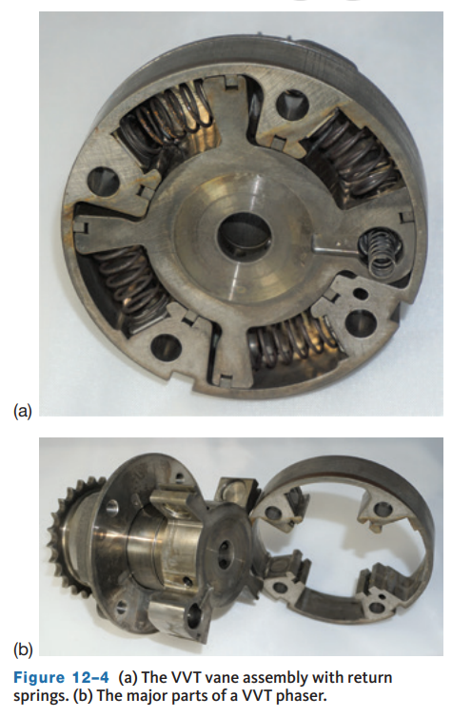
Variable Valve Timing
The variable valve timing (VVT) system electronically adjusts valve overlap by changing exhaust valve opening times in response to engine speed and load.
The system provides an increase in horsepower and torque. It also reduces fuel consumption and exhaust emissions.
This VVT system uses a special camshaft and phaser attached to the end of the camshaft. Inside the phaser are vanes that move within a fixed cavity inside a sealed hub.
The movement of the vanes is controlled by oil pressure he applied oil pressure is controlled by the powertrain control module (PCM).
The PCM transmits a signal to a solenoid to move a valve spool that regulates the flow of oil to the phaser cavity.
As the applied oil pressure increases, the vanes move against spring pressure. Each vane can rotate a total of 22.5 degrees.

Slide 9
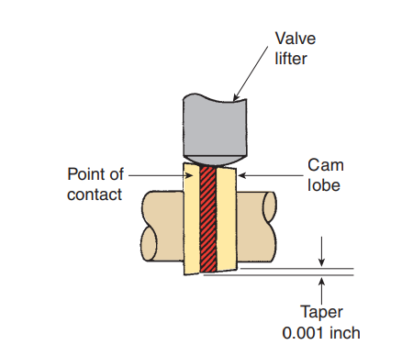
Valve Lifters
Valve lifters, sometimes called cam followers or tappets, follow the shape of the cam lobe.
Solid lifters provide a rigid connection between the camshaft and the valves.
Hydraulic valve lifters provide the same connection but use oil to absorb the shock that results from the movement of the valve train.
Hydraulic lifters are designed to automatically compensate for the effects of engine temperature. Changes in temperature cause valve train components to expand and contract. Hydraulic lifters automatically maintain a direct connection between valve train parts.
Solid lifters require a clearance between the parts of the valve train. This clearance allows for component expansion as the engine gets hot.

Slide 10
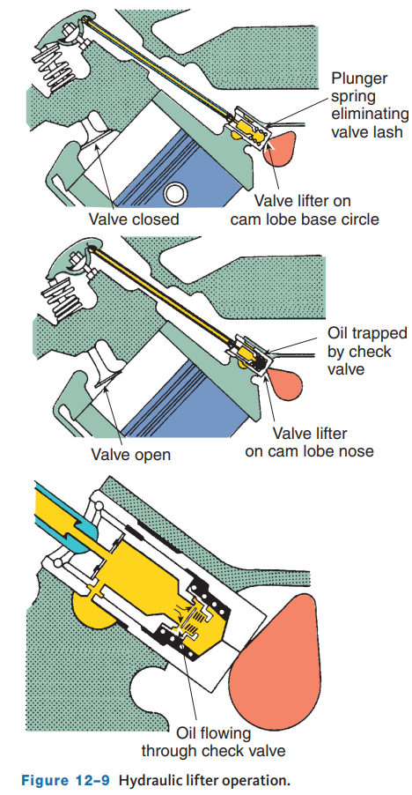
Operation of Hydraulic Valve Lifters
A hydraulic lifter has a plunger, oil metering valve, pushrod seat, check valve spring, and a plunger return spring housed in a hardened iron body.
When the lifter is resting on the cam’s base circle, the valve is closed and the lifter maintains a zero clearance in the valve train.
Oil is fed to the lifter through feed holes in its bore. Oil pressure forces the lifter’s check valve closed to keep the oil inside the lifter.
When there is some clearance in the valve train, a spring between the plunger and lifter body pushes the plunger up to eliminate the clearance.
As the cam lobe turns and opens a valve, the lifter’s oil feed hole moves away from the oil feed in the lifter bore. New oil cannot enter the lifter.
The effort to open the valve pushes the lifter’s plunger down slightly. This allows a small amount of oil to leak out; this is called leakdown. When the lifter returns to the base of the cam, oil can again fill the lifter.

Slide 11
Discussion
Hydraulic lifters are very common and have mostly replaced solid lifters.
Have a class discussion about why you suspect the hydraulic lifter has become more common and what advantages it offers from the perspective of the customer.

Slide 12
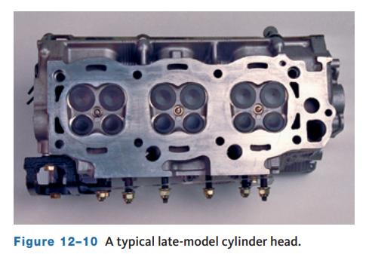
Cylinder Head (1 of 3)
12.03 Describe the purpose of an engine’s cylinder head, valves, and related valve parts.
On OHV engines, the cylinder head contains the valves, valve seats, valve guides, valve springs, rocker arm supports, and a recessed area that makes up the top portion of the combustion chamber.
On OHC engines, the cylinder head contains these items, plus the supports for the camshaft and camshaft bearings.
All cylinder heads contain passages that match passages in the cylinder block.
These passages allow coolant to circulate in the head and oil to drain back into the oil pan.
Oil also moves through the head to lube the camshaft and valve train.
The cylinder head also has tapped holes for spark plugs.

Slide 13
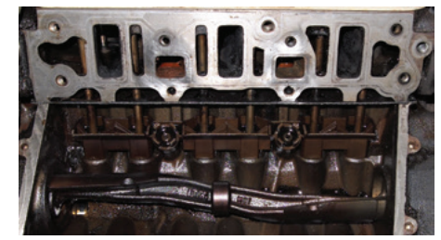
Cylinder Head (2 of 3)
Ports
  Intake and exhaust ports are cast into the cylinder head.
  Normally, there is one port for each valve.
  The intake and exhaust ports may be located on the same side of the combustion chamber or set on the opposites of the chamber.
  The ports in this arrangement are called cross-flow ports.
The sealing surface of the head must be flat and smooth. To aid in the sealing, a gasket is placed between the head and the block, called the head gasket.

Slide 14
Cylinder Head (3 of 3)
The performance of an engine, its fuel efficiency, and its exhaust emissions depend to a large extent on the shape of the combustion chamber.
The point of ignition should be at the center of the combustion chamber to minimize the distance from the spark to the furthest point in the chamber.
  Turbulence is the very rapid movement of gases. Turbulence improves combustion because the air and fuel are mixed better.
  Quenching is the mixing of gases by pressing them into a thin area, called the quench area.
In the wedge-type combustion chamber, the spark plug is located at the wide part of the wedge. The spark travels from a large area in the chamber to a smaller one, in the quench area.
The hemispherical combustion chamber is so named because of its basic shape. Hemi is defined as half, and spherical means circle, and the combustion chamber is shaped like a half circle.

Slide 15
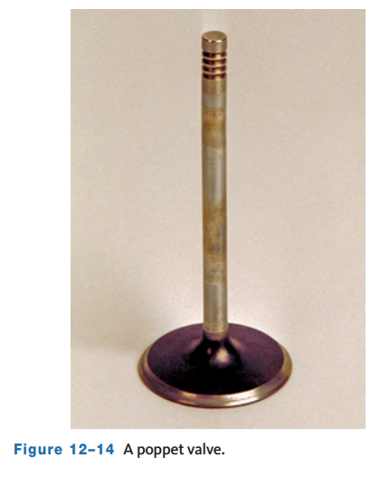
Intake and Exhaust Valves (1 of 4)
The intake and exhaust valves are also called poppet valves.
They tend to pop open and close.
When they open, intake air flows into the combustion chamber or exhaust gases leave it.
When closed, they seal the chamber.
An exhaust valve can be smaller because exhaust gases move more easily than intake air.

Slide 16
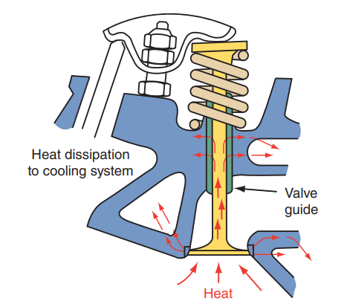
Intake and Exhaust Valves (2 of 4)
Most valves are made from hardened steel, steel alloys, or stainless steel. Other metals are often used in high-performance valves.
The material used to make a valve must be able to withstand high temperatures and be able to dissipate the heat quickly. Most of the heat is dissipated through the contact of the valve face and seat.
The heat then moves through the cylinder head to its coolant passages.
Heat is also transferred through the valve stem to the valve guide and again to the cylinder head.
Intake and exhaust valves are typically made with different materials.
Intake valves run cooler than exhaust valves. Therefore, intake valves need less heat resistance.

Slide 17
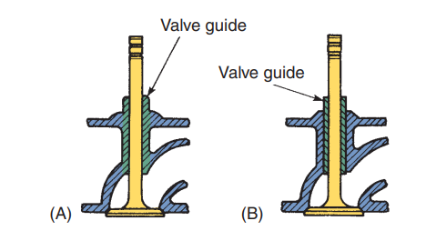
Intake and Exhaust Valves (3 of 4)
Valve guides support the valves and prevent them from moving in any direction other than up and down.
The inside diameter of a guide is machined to provide a very small clearance with the valve stem.
This clearance is important for the following reasons:
  It keeps oil from being drawn into the combustion chamber during the intake stroke, and it keeps oil from leaking into the exhaust port when the pressure in the exhaust port is lower than the pressure in the crankcase.
  It keeps exhaust gases from leaking into the crankcase past the exhaust valve stems during the exhaust stroke.
  It keeps the valve face in perfect alignment with the valve seat.
Valve guides can be cast integrally with the head, or they can be removable.

Slide 18
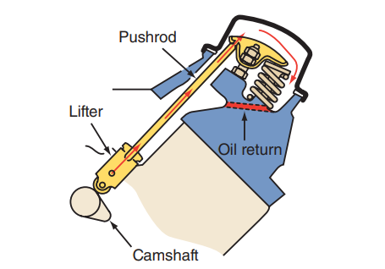
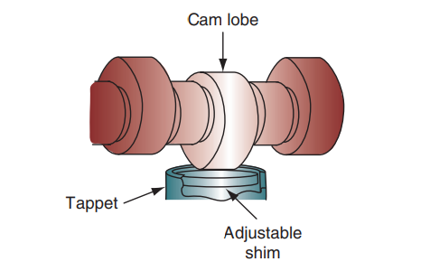
Intake and Exhaust Valves (4 of 4)
Rocker Arms: Rocker arms change the direction of the cam’s lifting force.
As the lifter and pushrod move upward, the rocker arm pivots at its center point which pushes the valve down.
Rocker arms also allow the valve to open farther than the actual lift of the cam lobe.
Pushrods: In an OHV engine, a pushrod is the connecting link between the rocker arm and the valve lifter. They transmit the rotation of the camshaft to the valves. The pushrods may have a hole in the center to allow oil to pass from the lifter to the rocker arm assembly.
Found on some OHC engines, cam followers are cups that provide a surface for the cam lobes to move the valves. Some followers have a hydraulic unit that fits under the cup to maintain proper valve clearance.

Slide 19
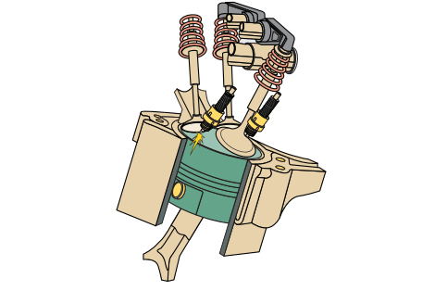
Multivalve Engines
Most newer engines use multivalve arrangements.
The basic reason for using more than one intake and/or exhaust valve is simple—better efficiency.
To improve efficiency, the flow in and out of the combustion chamber must be improved. In the past, this was attempted by making the valves larger and by changing valve timing.
Larger valves allowed more air in and more exhaust out, but the bigger valves are heavy and require stronger springs to close them. The stronger springs hold the valves closed tighter, and more engine power is required to open them.
Today, multivalve engines can have three, four, or five valves per cylinder.
The most common arrangement is four valves per cylinder with two intake and two exhaust valves.

Slide 20
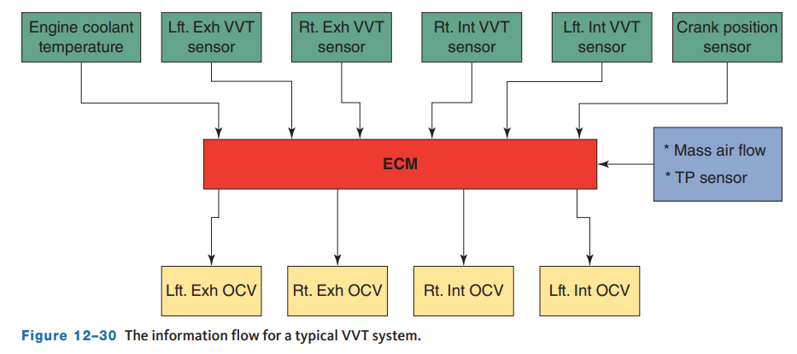
Variable Valve Timing and Lift Systems (1 of 5)
Changing valve timing in response to driving conditions improves driveability and lowers fuel consumption and emission levels.
There are many different variable valve timing (VVT) systems used on today’s engines.
An ECM advances or retards valve timing based on operating conditions, such as engine speed and load.
Continuously variable systems alter valve timing whenever operating conditions change. Continuously variable systems change the phasing or timing of a valve’s duration.
These systems provide a wider torque curve, reduction in fuel consumption, improved power at high speeds, and a reduction in emissions.

Slide 21
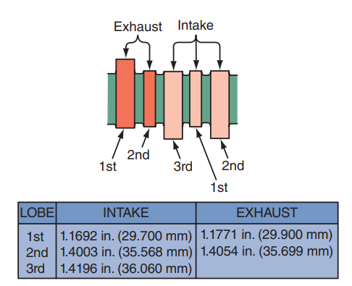
Variable Valve Timing and Lift Systems (2 of 5)
12.07 Describe the different ways manufacturers vary valve timing.
Most staged valve timing systems switch between two and more different camshaft profiles based on operating conditions. An example of this is Honda’s VTEC system used on multivalve engines.
The camshaft has three lobes for each pair of intake valves. The third lobe is shaped for more valve lift and different open and close times.
There is a rocker arm over each of the three lobes. At low engine speeds, only the second lobe’s rocker arms move the valves. At high speed, a solenoid valve sends pressurized oil through the rocker shaft to a piston in the outer rocker arms.
This pushes the piston partly into the center rocker arm, locking the three rocker arms together. The valves now open according to the shape of the third lobe.

Slide 22
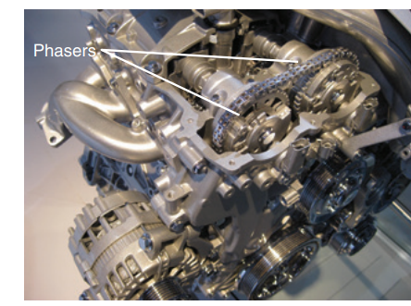
Variable Valve Timing and Lift Systems (3 of 5)
To provide continuously variable valve timing, camshafts are fitted with a phaser.
The phaser is mounted where a timing pulley, sprocket, or gear would be.
The phaser allows camshaft-to-crankshaft timing to change while the engine is running. Phasers can be electronically or hydraulically controlled. In a hydraulically controlled system, oil flow is controlled by the ECM.
Electronic systems rely on stepper motors.
Phasers are either based on a helical gear set or vanes enclosed in a housing.
As the hydraulically controlled piston moves, the helical splines on the piston and inner gear force the camshaft to change its position in relationship to the timing gear.

Slide 23
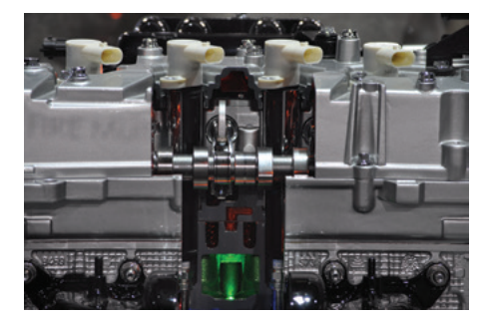
Variable Valve Timing and Lift Systems (4 of 5)
Fiat’s MultiAir (or UniAir) system is a variable valve lift and duration control system for gasoline or diesel engines.
It is a system that relies on mechanical, hydraulic, and electronic technologies. The system controls individual intake valves through the interaction of a roller cam follower, a hydraulic piston, a hydraulic chamber, an electronically controlled solenoid valve, and a hydraulic valve actuator.
The intake valves are controlled by the action of the hydraulic solenoid valve, which is controlled by an ECM.
When the solenoid valve is closed, trapped oil in the hydraulic chamber provides a solid link between the cam follower and the intake valve. Therefore, the intake valves operate according to the profile of the camshaft lobes.

Slide 24
Variable Valve Timing and Lift Systems (5 of 5)
A unique setup for controlling intake and exhaust valve timing and lift relies on a conventional camshaft, which is ground for high performance, with hydraulic lifters fitted with ultra-high-speed valves to bleed off the fluid.
The ECM changes the pressure in the lifter to delay valve openings, change valve duration, or prevent valves from opening.
A solenoid is used to control the flow of oil into a piston in each lifter that effectively determines the tappet’s height.
Another design uses pressurized oil to allow a four-valve-per-cylinder engine to operate as a three-valve engine at low speeds.
The primary valve opens and closes normally, while the secondary intake opens just enough to keep the engine running smoothly.
As the engine reaches 2,500 rpm, the ECM allows pressurized oil to move small pins that lock each pair of rocker arms together, causing both intake valves to follow the normal cam lobe. When the engine slows down, the pressurized oil is bled off and the pin releases, separating the two rocker arms.

Slide 25
Knowledge Check (1 of 2)
  True or False? VVT can increase horsepower while simultaneously lowering emissions.

Slide 26
Knowledge Check Answer (1 of 2)
  Answer: True. Changing valve timing in response to driving conditions improves driveability and lowers fuel consumption and emission levels.

Slide 27
Cylinder Deactivation
Cylinder deactivation works by keeping the intake and exhaust valves closed in a group of the engine’s cylinders.
This decreases the working displacement of the engine and provides an increase in fuel economy and reduced emissions.
The systems are designed to make the deactivation and activation of the cylinders unnoticeable to the driver.
This is accomplished by controlling the fuel injectors, ignition timing, throttle opening, and valve timing.
OHC engines typically have a pair of rocker arms at each valve. One of the rocker arms rides on the camshaft lobe and the other works the valve.
When the two rocker arms are locked together, the valve moves according to the rotation of the camshaft. To disable a cylinder, the rocker arms are unlocked.
The rocker arm on the cam lobe continues to work but does not transfer its movement to the other. The locking device is simply a pin that moves in response to oil pressure. A solenoid, controlled by the ECM, directs oil pressure to the pin.

Slide 28
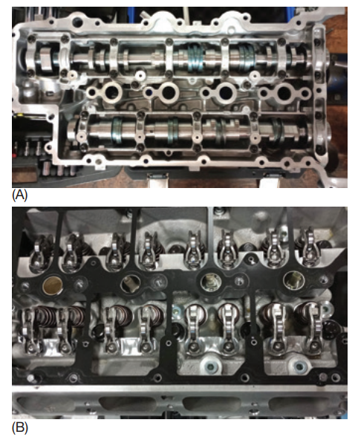
Cylinder Head Disassembly (1 of 3)
Cylinder Head Disassembly: On some engines, the rocker arms must be removed before the head is disassembled.
If the camshaft rides directly above the rocker arms, use the appropriate spring compressor and depress the valve enough to pull the rocker arm out.
Some have the rocker arms mounted on a separate shaft. The ends of the rocker arms do not directly contact the valves; rather a bridge rocker arm is used.
The bridge rocker arm assembly is also mounted on a shaft. To remove these rocker arms, both shafts are unbolted.
On all OHC engines, the camshaft must be removed before the cylinder head can be disassembled.
Follow the specified order for loosening the camshaft bearing caps. Keep the caps in the order they were on the head.

Slide 29
Cylinder Head Disassembly (2 of 3)
Measure the installed spring height for each valve.
This measurement will be needed during reassembly.
To remove the valves, use a valve spring compressor. First, select a socket that fits over the valve tip and onto the retainer.
Tap the socket with a plastic mallet to loosen the keepers.
Select the correct adaptor or adjust the jaws of the compressor so that they fit securely over the spring retainers.
Compress the valve springs just enough to remove the keepers.
Next, remove the valve oil seals and valves. Keep the assemblies together according to the cylinder they were in.
If a valve cannot pass through its guide, its tip might be mushroomed or peened over.
Do not force the valve through the guide. It could score or crack the valve guide or head. Raise the stem and file off the ridge until the stem slides through the guide easily.

Slide 30
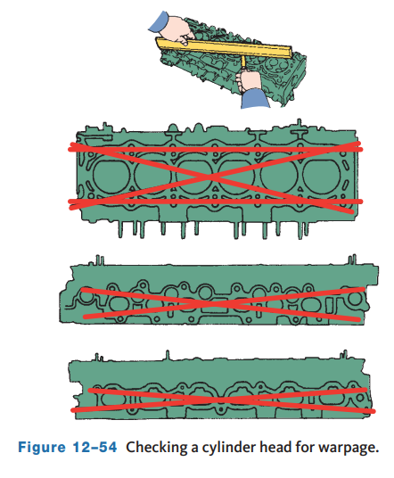
Cylinder Head Disassembly (3 of 3)
Inspection of Head Cylinder
  As engines undergo heating and cooling cycles over their life span, certain parts tend to warp.
  By using a precision straightedge and feeler gauge, the amount of warpage can be measured.
  The surface should be checked both across the head as well as lengthwise.
  In general, the maximum allowable deformation is 0.004 inch (0.1016 mm).

Slide 31
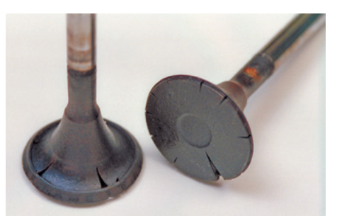
Valves
Each valve face should be checked for evidence of burning or signs of wear or distortion.
Replace any valves that are badly burned, worn, or bent.
Discard any valve that is badly burned, cracked, pitted, or shows signs of excessive wear. Examine the facings on the stem.
If the plating is flaking or chipped, the valve should be replaced. Examine the backside of the intake valves.
A black oily buildup on the neck and stem area indicates that oil is entering the cylinder through the intake valve or valve guide seats.
Measure the margin on the valve. Valves that cannot be refaced without leaving at least a 1⁄32-inch (0.79 mm) valve margin should not be reused.

Slide 32
Valve Seats
Valve seats should be checked for damage, cracks, burning, and deterioration. Also, check insert seats for looseness in their bores.
If any damage is found on the seat, a new insert seat can be installed. If an integral seat is damaged, the area around it will need to be cut out and an insert seat installed.
If the seat appears to have sunk too deeply in its bore, it needs to be replaced. A seat should also be replaced if its valve was broken or bent. A worn retainer will allow the spring to move away from the centerline of the valve. This affects valve operation because spring tension on the valve will not be evenly distributed.
Each retainer should be carefully inspected for cracks. The inside shape of most retainers is a cone that matches the outside shape of the keepers. There must be a good fit to secure the keepers in their grooves on the valve stem. If the retainers and keepers show damage or wear, they should be replaced.
The valve stem grooves should match the inside shape of the keepers. Some valves have multiple keeper grooves. Others have only one. All of the valve stem grooves should be inspected for damage and fit by inserting a keeper in them.

Slide 33
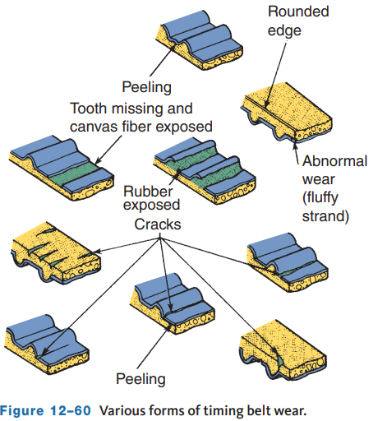
Inspection of the Valve Train (1 of 4)
When inspecting the valve train, each part should be carefully checked.
Belt failure is commonly due to insufficient tensioning, extended service life, abusive operation, or worn tensioners. Most manufacturers recommend timing belt replacement every 60,000 miles.
Loose timing belts will jump across the teeth of the timing sprockets, causing shearing of the belt teeth. Check for cord separation and cracks on all surfaces of the belt.
Also check for evidence of exposure to oil or water.
On many engines, severe engine damage can result from a broken timing belt.
When a timing belt breaks, the camshaft no longer turns, but the crankshaft continues to rotate, causing the pistons to contact the valves.

Slide 34
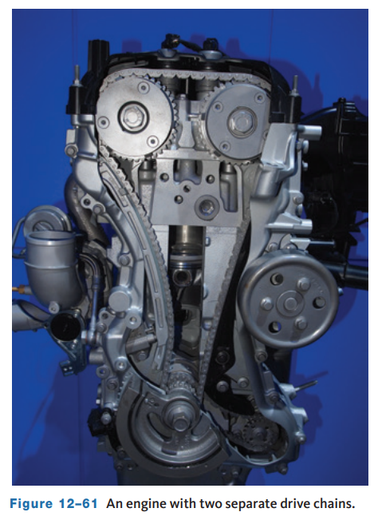
Inspection of the Valve Train (2 of 4)
Timing Chains: Late-model engines may have many drive chains.
Those with one chain use it to drive the camshaft(s) by the crankshaft.
Each drive chain should be inspected and replaced if it is damaged.
The length of the chain should also be checked.
  Some manufacturers recommend measuring the entire length of the chain and comparing that to specifications.
  The chains on other engines should be measured in sections while they are being stretched. To do this, pull the chain with the specified tension. Then measure the length of the specified number of chain links.

Slide 35
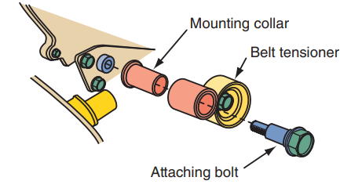
Inspection of the Valve Train (3 of 4)
The tensioners of belt and chain drive systems should be checked.
Check the surface of the tensioner’s pulley. It should be smooth and have no buildup of grease or oil.
Most belt tensioners should also be checked for signs of lubricant leakage. Check around the seal. If any damage or leakage is evident, the tensioner should be replaced.
The action of a belt tensioner should be checked. Make sure the spring is free to move the tensioner pulley. If the tensioner spring is defective, replace the tensioner.
On plunger-type tensioners, hold the tensioner with both hands and push the pushrod strongly against a flat surface. The pushrod should not move. If it does, replace the tensioner.
Measure the distance the pushrod extends from the housing. Compare that distance to specifications.

Slide 36
Inspection of the Valve Train (4 of 4)
Camshaft phasers can be checked while it is attached to the camshaft.
Clamp the camshaft in a soft-jawed vise. Attempt to rotate the timing gear on the phaser. If it moves, the phaser must be replaced.
During inspection, some pushrods may have a groove worn in the area where they pass through the cylinder head, and some may have tip wear. All damaged pushrods should be replaced. Hollow pushrods should be thoroughly cleaned so that there are no blockages in the bore. Also, the ends of the pushrods should be checked for nicks, grooves, roughness, or signs of excessive wear. Check the straightness of each of the pushrods.
Camshaft and Bearings: The camshafts in most OHC engines are secured to the cylinder head by bearing caps. Some ride on split bearings, whereas others ride on a machined surface in the cylinder head. The bearings or bearing surface should be carefully inspected for signs of unusual wear. If the engine is equipped with camshaft bearings, they are normally replaced during engine rebuilding.

Slide 37
Servicing Cylinder Heads (1 of 2)
Service to the cylinder head may involve many different procedures. These vary with the metal used to make the head and the design of the engine.
Crack Repair: Common locations of cracks in a cylinder head include: between the spark plug bore and the valve seat, between the valve seats, around the valve guides, and in the exhaust ports.
In most cases, a cracked head should be replaced. However, some cracks can be effectively repaired. Crack repair is normally done by specialty shops.
The cause of the cracking needs to be identified and corrected.
No matter what caused the crack, the crack needs to be repaired if the head is reused.
Crack repair is done by the cold process of pinning or the hot process of welding.

Slide 38
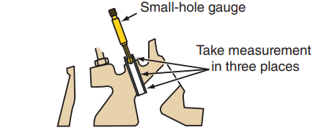
Servicing Cylinder Heads (2 of 2)
The amount a valve guide is worn can be measured with a ball (small-bore) gauge and micrometer. Insert and expand the ball gauge at the top of the guide, then measure the ball gauge with an outside micrometer. Repeat this process with the ball gauge in the middle and the bottom of the guide.
Any difference in reading indicates taper or wear inside the guide. Compare the measured diameter to specifications.
A dial indicator can also be used in a different procedure.
Although oil consumption is more of a problem with sloppy or worn intake guides, oil can also be pulled down the exhaust guides by the suction created in the exhaust port.

Slide 39
Valve Stem Seals (1 of 2)
Valve stem seals are used to control the amount of oil that flows between the valve stem and the guide.
Insufficient lubrication will allow the stems and guides to scuff and wear.
Too much oil causes a buildup of heavy deposits on the intake valve and hard deposits on the exhaust valve stem.
Worn valve stem seals can increase oil consumption by as much as 70 percent. There are basically three types of seals.
Positive seals fit tightly around the top of the guide and scrape oil off the valve stem as it moves up and down.
Deflector, splash, or umbrella-type seals ride up and down on the valve stems to deflect oil away from the guides.
O-ring seals are used to prevent oil from moving into the guide when the valve is open. If replacing valve stem seals on an engine still installed in the vehicle, remove the valve cover(s) and spark plugs.

Slide 40
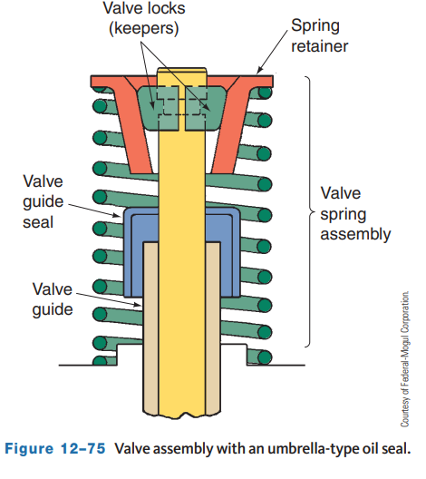
Valve Stem Seals (2 of 2)
To keep the valves from dropping down into the guides, compressed air is used to pressurize the cylinder.
To install a positive valve seal, place the plastic sleeve from the seal kit over the end of the valve stem to protect the seal as it slides over the keeper grooves. Lightly lubricate the sleeve before pushing and seating the seal in place.
Installing Umbrella-Type Valve Seals: An umbrella-type seal is installed on the valve stem before the spring is installed. It is pushed down on the valve stem until it touches the valve guide boss.
Installing O-Rings: When installing O-rings, use engine oil to lightly lubricate the O-ring. Then install it in the lower groove of the lock section of the valve stem. Make sure the O-ring is not twisted.

Slide 41
Assembling the Cylinder Head (1 of 2)
Before a cylinder head is reassembled and installed, two measurements must be checked:
  Installed stem height is the distance between the spring seat and stem tip. A number of tools can be used to obtain an accurate stem height reading, including a depth micrometer, vernier caliper, and telescoping gauge.
  Installed spring height is measured from the spring seat to the underside of the retainer when it is assembled with keepers.
    This measurement can be made with a set of dividers or scales, telescoping gauge, or spring height gauge. Adjustments to valve spring height can be made with valve spring inserts, also known as spring shims.
    These shims come only in three standard thicknesses—0.060, 0.030, and 0.015 inch (1.52, 0.7620, and 0.3810 mm).
    Using combinations of different shims allows compensation for variations in spring height.

Slide 42
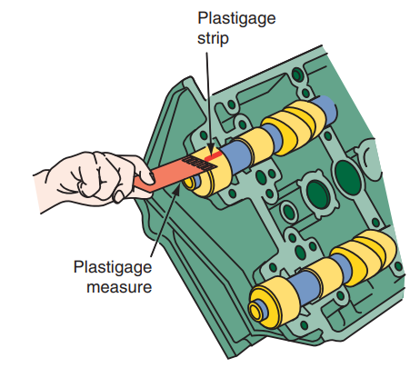
Assembling the Cylinder Head (2 of 2)
After the valves are installed and the cylinder head is assembled, the camshaft can be installed in the cylinder head. Some engines have a separate camshaft housing that bolts to the cylinder head. This should be installed with the proper seals and gaskets.
On OHC engines, if the engine uses full-round insert bearings, press them into the bores in the cylinder head.
After each bearing is fully seated in its bore, double-check the alignment of the bearing’s oil hole with the oil hole in the head.
Working with these bearings is like working with crankshaft main bearings.
This includes checking bearing clearances with Plastigage.
Prior to installation, wipe off each cam bearing with a lint-free cloth, then thoroughly coat the camshaft lobes and bearing journals with the lube recommended by the manufacturer.

Slide 43
Knowledge Check (2 of 2)
When replacing valve guide seals with the engine in the vehicle, what should be done to prevent the valves from falling into the cylinder when the valve springs are removed?

Slide 44
Knowledge Check Answer (2 of 2)
To keep the valves from dropping down into the guides, compressed air is used to pressurize the cylinder.
It is also recommended to bring that cylinder to TDC.

Slide 45
Chapter Reflection
Please take a moment to compare your perception of the automotive industry before and after you studied this chapter. Then respond to the following questions in one or two paragraphs. Use 150–200 words in your reflection.
Did anything in this chapter change your thinking about upper end theory and service.
Considering all you have learned, do you feel you are able to perform some of these upper end service procedures outlined in the chapter? How can you prepare further?

